Slide 1
Unit 10 Live Session
Model Identification for Non Stationary Data

Slide 2
Final Exam Announcements
Final Exam in Cumulative
There will be an in-class portion. This will be similar to all the problems on the midterm except for the last one. This will be on the last day of class.
There will also be a take home portion that you will get at the end of the in-class portion and will be due on that Saturday.

Slide 3
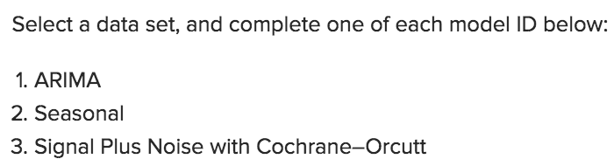
Break Out 1
There may be several different approaches to how the first part of For Live Session was interpreted. Simply describe what you did for these questions:
Some students generated data, some used a dataset and analyzed it with all three, some did an alternative analysis. As I looked through them, all the ones I saw before live session were very creative and very useful. Simply discuss your thoughts and explain your analysis!

Slide 4
Break Out 2

Slide 5
Question 1
What is the Ho and Ha of the Dickey-Fuller Test? Do this from memory if you can.

Slide 6
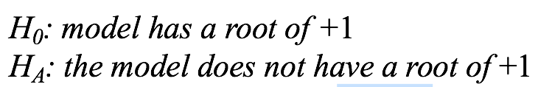
Question 2
Consider the Dicky Fuller Test. If we conclude that there is no evidence of a unit root when a unit root is present in the model, what type of error have we made?
Type I
Type II
Type III

Slide 7
Question 3
What is the Ho and Ha of the Cochrane Orcutt Test? Do this from memory if you can.

Slide 8
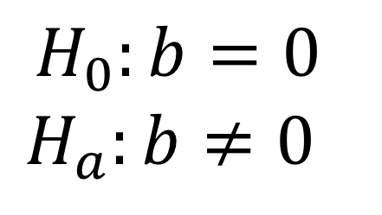
Question 4
Consider the Cochrane Orcutt Test. If we conclude that there is not enough evidence to suggest non zero slope (when the slope is actually not 0), what kind of error have we made?
Type I
Type II
Type III
$$H_{0}:b=0$$
$$H_{a}:b≠0$$

Slide 9
Break Out 3

Slide 10

Forecasting Using Signal Plus Noise and the Cosine (patemp data)
Use the help function (?fore.signalplusnoise.wge) to help you figure out how to fit a signal plus noise model to the Pennsylvania temperature data (patemp).
Write the specification of the model with the estimated white noise variance.
Hint:
bo = intercept, A1 = xmtx1, A2 = xmtx2 from attribute b.
In addition, find the ASE associated with the best model you can fit to the data. (n.ahead = 24)
Compare this with the ASE from the fit of a model with a (1-B^12) in the model (n.ahead = 24)
Why is the (1-B^12) model not recommended for this data?

